Slide 1

Amazon Sales Data Analysis
Report By: Aditya Chikte

Slide 2
Introduction
Amazon, a global e-commerce giant, has been revolutionizing the way people shop online since its inception. With a vast product range, seamless shopping experience, and innovative services like Amazon Prime, the company has cemented its position as a market leader in the retail industry.
As a leader in online retail, Amazon continuously seeks to enhance its sales performance to stay ahead in the competitive market landscape.

Slide 3
Objectives
Analyze monthly, yearly, and yearly-monthly sales trends to identify patterns and fluctuations over time.
Investigate how factors like product price, sales volume, and order priorities influence overall revenue and profit.
Determine which product categories drive the most revenue and profitability for Amazon.
Calculate essential metrics like total sales, profit margins, and average unit price to gauge overall performance.
Evaluate the effectiveness of sales channels in driving revenue growth.
Provide actionable insights and recommendations to optimize sales strategies and maximize profitability.

Slide 4
Project Overview
A. Dataset Detail:
Source: The dataset has been provided by Unified Mentors and the file name was “Amazon Sales Data.csv”.
Format: CSV (Comma-Separated Values)
Size: 100
B. Domain: E-commerce
C. Technology and tools used:
Python: Used for data preprocessing, analysis, modeling and visualization.
Google Colab: Utilized as the primary development environment for running Python code

Slide 5
Methodology and Process
Data Cleaning and Preprocessing
Exploratory Data Analysis (EDA)
Data Analysis
Data Visualization
Insights and Conclusion
Summary

Slide 6
Data Cleaning and Preprocessing
The dataset was examined for any missing values, but no missing values were found.
The 'Order Date' and 'Ship Date' columns were converted from string format to datetime format.
By extracting the month and year from the 'Order Date' column, additional columns with name 'Order Month' and 'Order Year' were created.

Slide 7
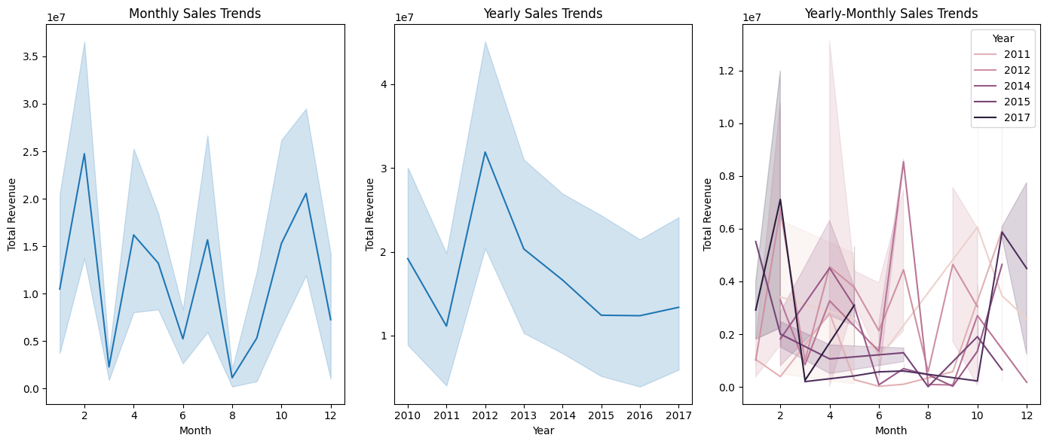
Exploratory Data Analysis (EDA)
Explored sales trends on a monthly, yearly, and yearly-monthly basis.

Slide 8
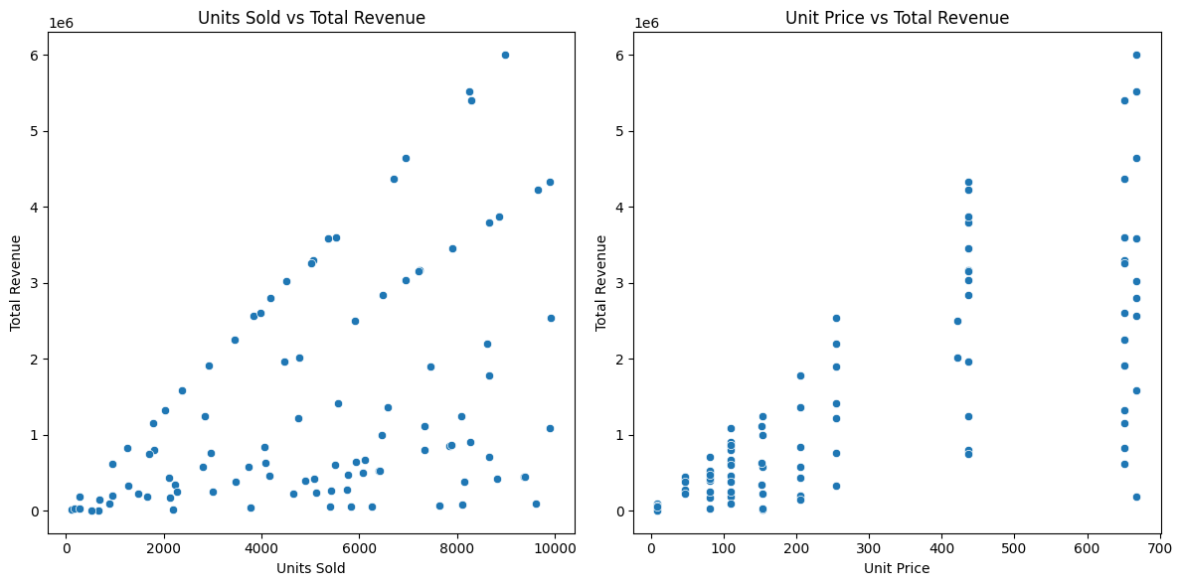
Exploratory Data Analysis (EDA)
Investigated relationships between sales volume, product price, and revenue.

Slide 9
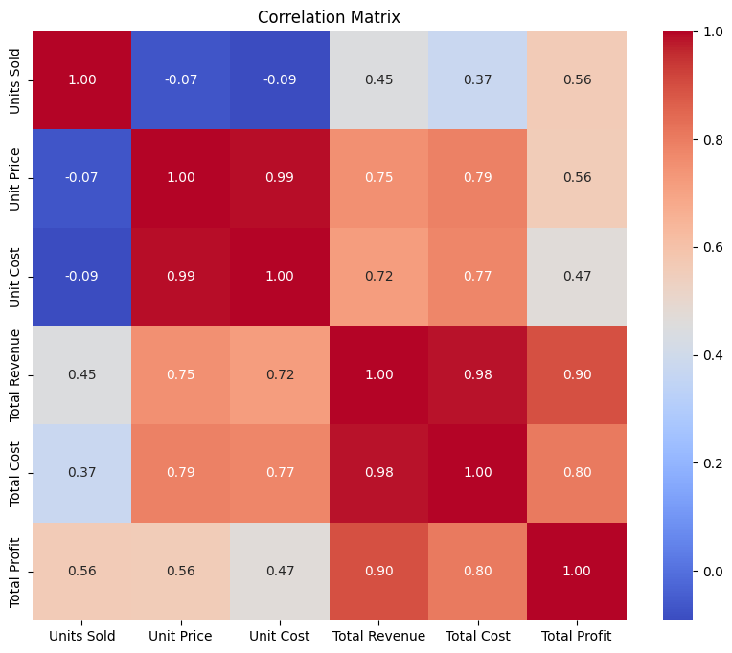
Exploratory Data Analysis (EDA)
Visualized correlation matrix using heatmap.

Slide 10
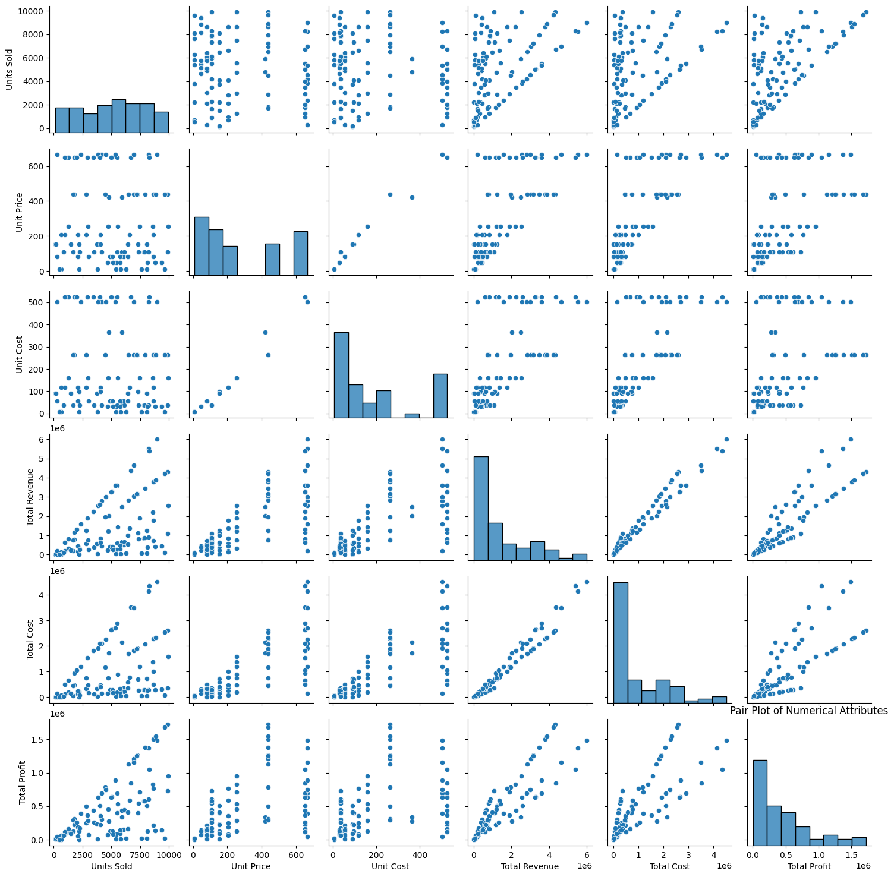
Exploratory Data Analysis (EDA)
Analyzed correlations between numerical attributes using scatter plots and pair plots.

Slide 11
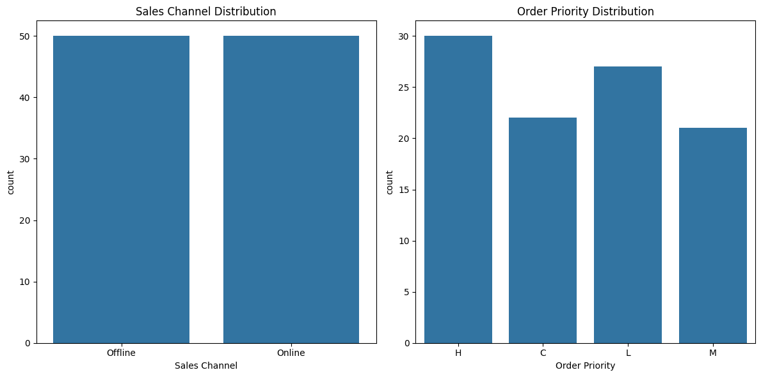
Exploratory Data Analysis (EDA)
Explored categorical variables such as sales channels and order priorities using count plots.

Slide 12
Exploratory Data Analysis (EDA)
Further, Calculated average sales per month and year.
Identified top-selling product categories and their contribution to revenue.
Visualized sales data using various plots and charts for easy interpretation.

Slide 13
Data Analysis
Calculated essential metrics including total sales, profit margins, and average unit price.
Determined which order priorities generated the highest sales.
Identified the best-selling item types and their impact on revenue.
Analyzed the effectiveness of different sales channels in generating maximum sales.
Computed yearly total sales to understand overall sales performance.
Examined total sales and profits by region to identify high-performing regions.
Investigated the number of units sold for specific item types to gauge product popularity and demand.

Slide 14
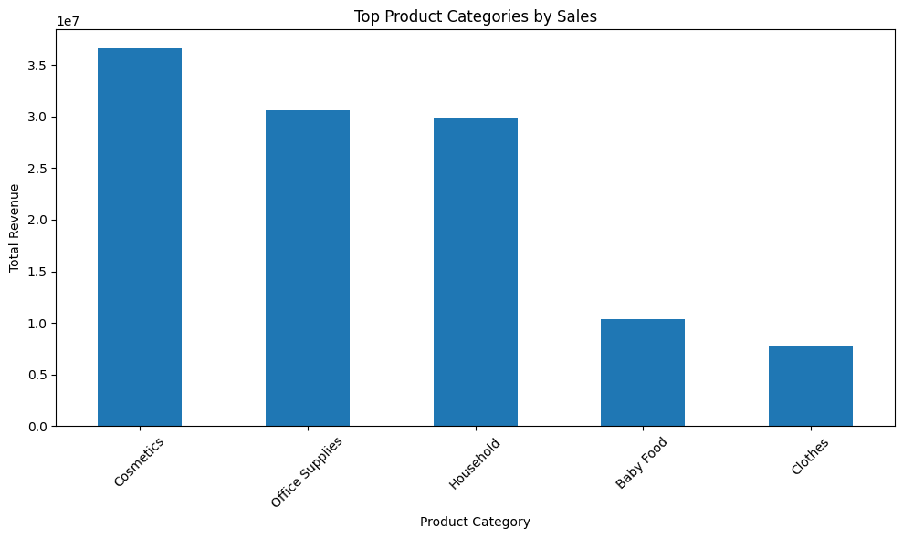
Data Visualization
Created a bar chart to visualize the top product categories by sales revenue.

Slide 15
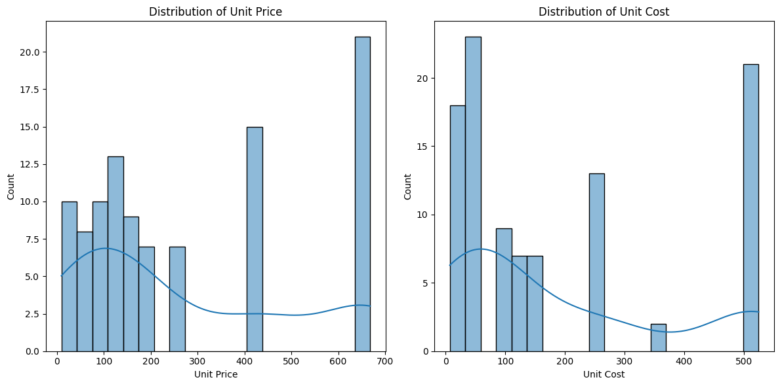
Data Visualization
Explored the relationship between unit price, unit cost, and total revenue through scatter plots to understand the impact of pricing on sales performance.

Slide 16
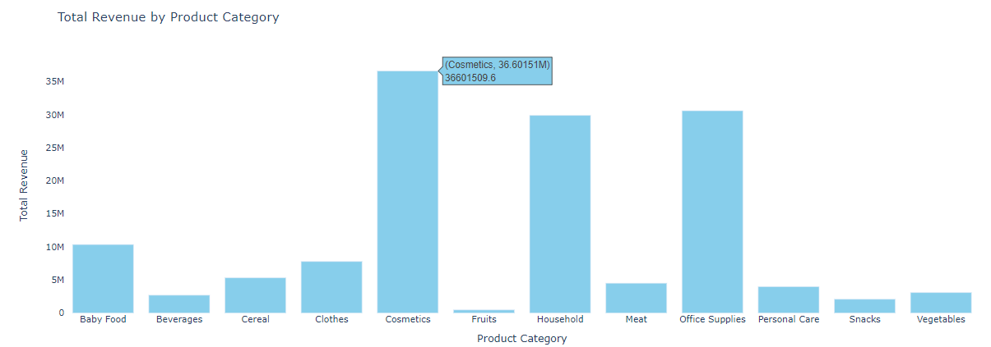
Data Visualization
Created an interactive bar chart to visualize total revenue by product category, highlighting the top-performing categories contributing to overall sales.

Slide 17
Insights
The total cost amounts to approximately $93.18 million, while the total profit stands at approximately $44.17 million, resulting in a percentage profit of approx. 47.42%.
February and November exhibit the highest average monthly sales, with approximately $1.90 million and $2.29 million, respectively.
The year 2010 has the highest average yearly sales, totaling approximately $1.92 million, while 2011 has the lowest, with around $927,430.
“Cosmetics” emerge as the top-selling product category, generating approximately $36.60 million in revenue.

Slide 18
Conclusion
The analysis reveals various trends and relationships in the sales data.
Monthly sales exhibit seasonal variations, with higher sales during certain months.
Yearly sales have been increasing steadily over the years, indicating overall business growth.
There is a strong positive correlation between units sold and total revenue, indicating that higher sales volumes contribute to higher revenue.
The correlation matrix highlights strong correlations between units sold, total revenue, and total profit, suggesting that these variables are closely related.

Slide 19
Recommendations for improving sales performance
Explore targeted marketing strategies to capitalize on peak sales months and drive sales during slower months.
Analyze pricing strategies to optimize profit margins while maintaining competitive pricing.
Consider expanding product offerings or entering new markets to further drive revenue growth.

Slide 20
Summary
The analysis of Amazon sales data revealed valuable insights into sales trends, product performance, and profitability.
Monthly sales exhibit seasonal variations, with peak sales observed in February and November, suggesting the influence of external factors or promotional events.
Yearly sales have displayed consistent growth trends over the years, with 2010 recording the highest average yearly sales, indicating the overall business growth trajectory.
"Cosmetics" emerged as the top-selling product category, contributing significantly to total revenue, highlighting consumer preferences or market demands.

Slide 21
Summary
Strong positive correlations between units sold, total revenue, and total profit underscore the importance of sales volume in driving profitability.
Recommendations for improving sales performance include exploring targeted marketing strategies, analyzing pricing strategies to optimize profit margins, and considering expanding product offerings or entering new markets to further drive revenue growth.
These insights provide valuable guidance for strategic decision-making and optimizing sales strategies to maximize revenue and profitability in the e-commerce domain.

Slide 22
Thank you

